Slide 1

Lifestyle
By Hui Zhou, Nicole Morris, & Qi Liu

Slide 2
App Structure
Change to MVVM
Integrate Gestures & Step Counter

Slide 3
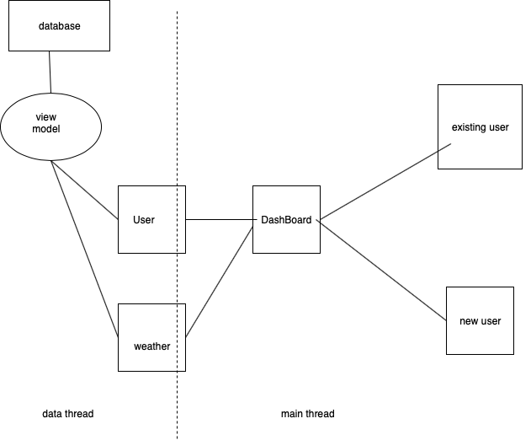
Original Class Diagram
User

Slide 4
New Class Diagram

Slide 5
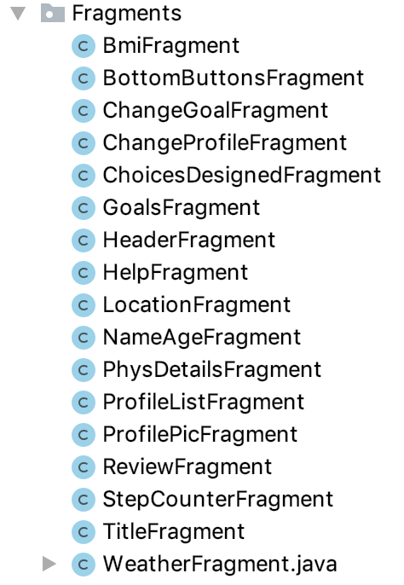
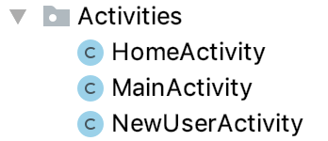
Original UI Components
3 Activities
16 Fragments

Slide 6
Current UI Components
3 Activities
17 Fragments
Added 1 Fragment

Slide 7
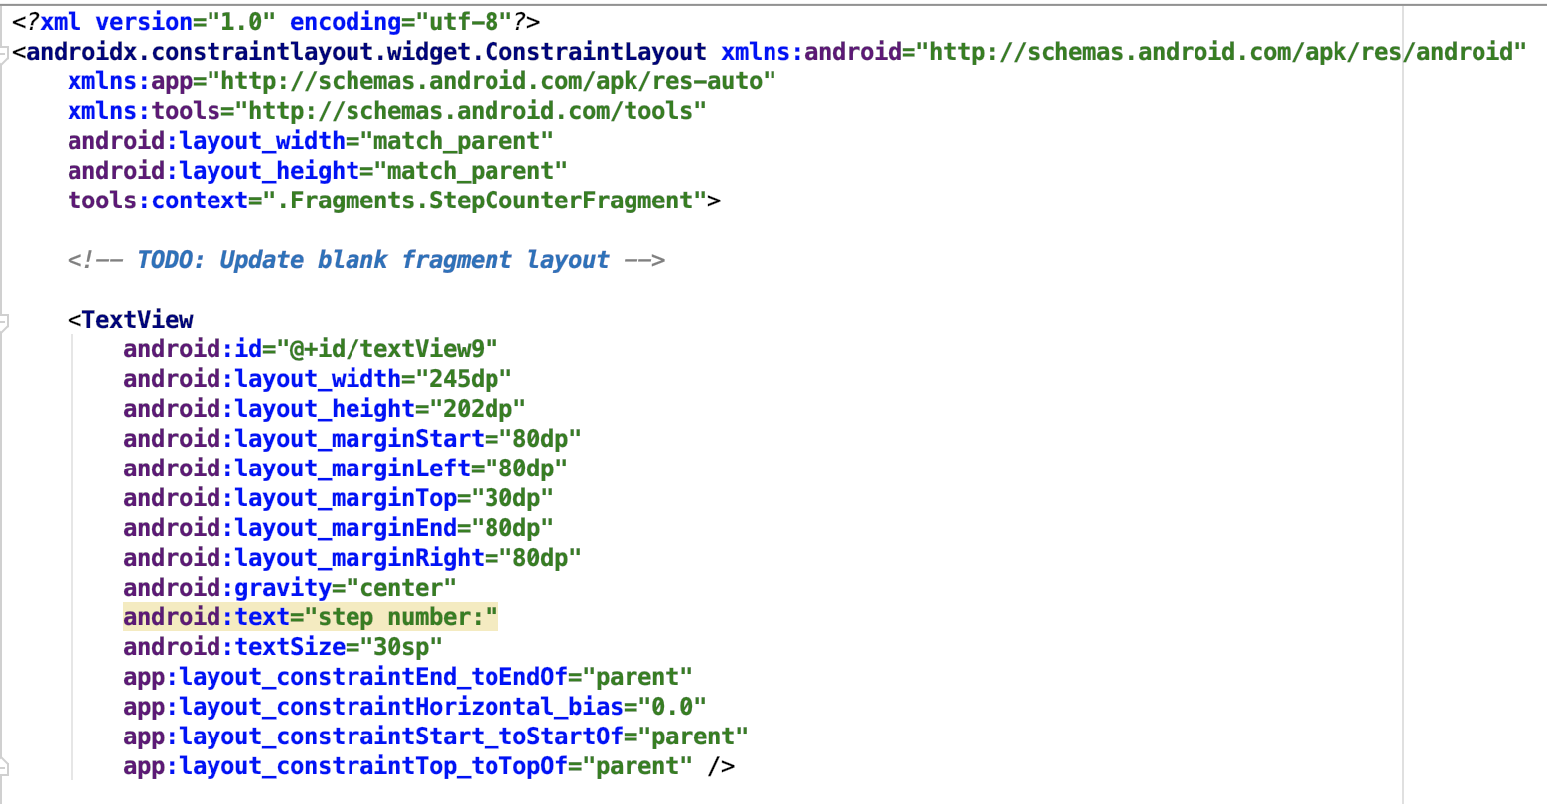
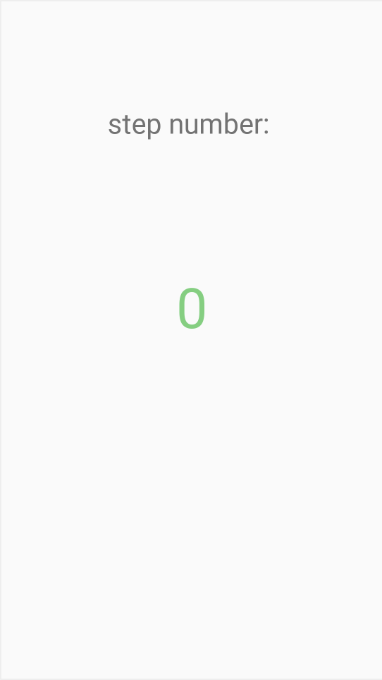
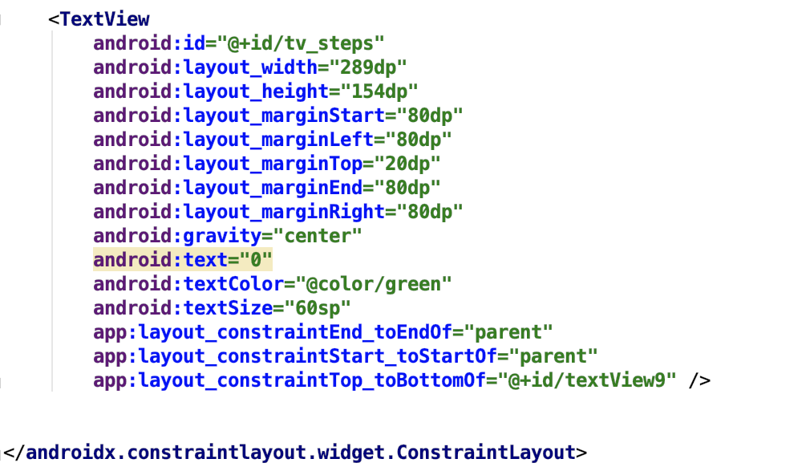
Step Counter Fragment

Slide 8
App Demo
Gestures & Step Counter

Slide 9
Gesture/Sensor Flow
Main Activity
StartGesture
(Stops itself)
StepCounter
StopGesture
(Stops itself)

Slide 10
Testing
Android Phone & Debuggers

Slide 11
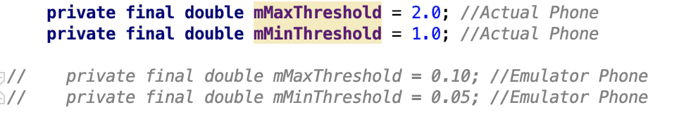
Threshold Testing

Slide 12
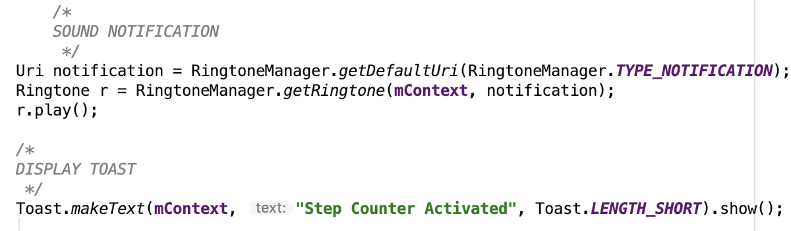
Sound/Toast Testing

Slide 13


Debugger/Breakpoint Testing
Updating steps from stepcounter sensor
Displaying updated steps in fragment

Slide 14
Cloud Backup
AWS

Slide 15
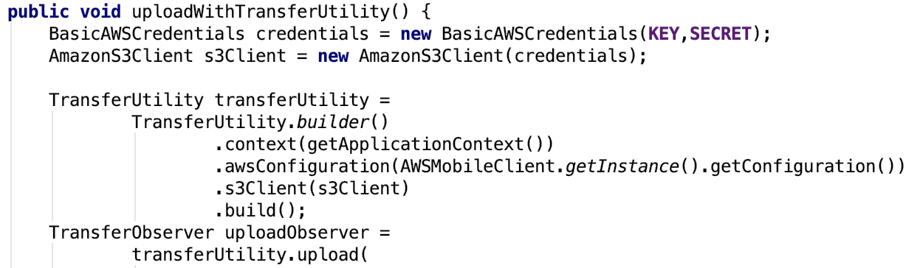
Uploading to AWS S3 Bucket
Create New User
Change User Profile

Slide 16
Questions?

